Slide 1
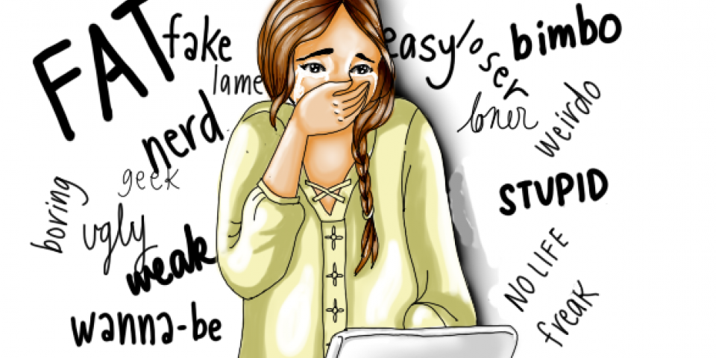
A New Kind of Bully

Slide 2
Megan Meier November 6, 1992 – October 17, 2006

Slide 3
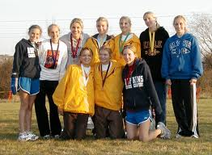
Just How Big Is The Problem?

Slide 4
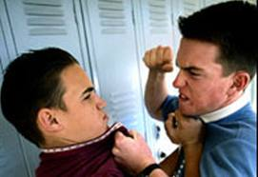
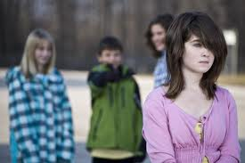
Schools Should Get Involved

Slide 5
Simply Unrealistic

Slide 6
Freedom of Speech

Slide 7
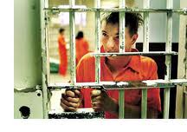
Parental Responsibility

Slide 8
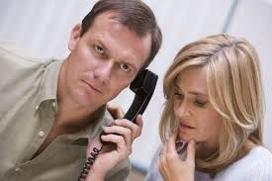
Where to Turn?

